Slide 1
Insights from Planet imagery and crop timing plan
Jan 4, 2018

Slide 2
General observations
Unreasonable estimates are usually due to misclassified land use; if land use is correct, the estimate is usually reasonable
CAR polys seem to cut through what looks like a cohesive field – maybe CAR polys aren’t totally correct or mean something different than I’m assuming
In Mato Grosso, much of Jake’s single cropping pixels are actually double cropping
The Matopiba survey doesn’t reflect the change in planting/harvest dates across the CAR polygon and is too stable over the years to be trustworthy. Survey reports don’tvalidate as well as timeseries analysis dates, probably because of recall error; tend to report the same dates for all years even though Planet images don’t reflect it. Matopiba survey is probably wrong; doesn’t take two months to harvest on a small plot. Also maybe they reported a failed crop as the actual planting date; see an example of an early greenup followed soon by brown; this corresponded to the Matopiba reported planting date. Try to use only recent years to calibrate and validate. Rely on the crop progress reports instead?
Failed crops and weeds may impact which peak is detected as the crop peak…
Interfield variations happen very ‘fast’ across space, and the variations are very large.
500m isn’t enough to resolve natural vegetation
Planet validation in MT indicate a need to think about whether polygons are appropriate for aggregation, and if so, how to mask out pixels and whether to divide a polygon into separate pieces.

Slide 3
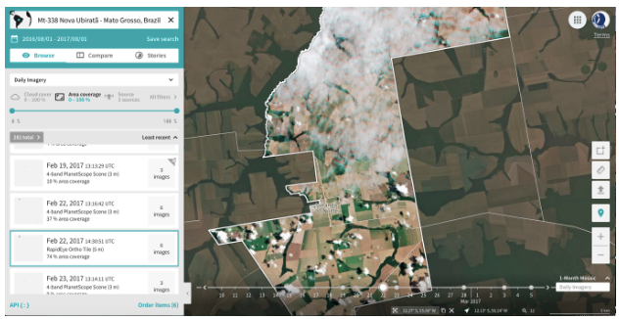
Issues with aggregation and analysis
Small portions of each property have completely different crop cycles
One part of field is bare while the other part are at peak greenness
One part is single cropped, but seems to happen during the time of the second crop
Planting and harvesting seem to happen in a scattered way – i.e. nonadjacent fields in a CAR poly seem to be planted at the same time. In other words, especially for larger CAR polys, the within poly variation is probably equal to interpoly variation
Quantile correction with crop progress reports in Mato Grosso
Use only MODIS pixels that have > 80% area classified as soy, or only report CAR polygons that have > 80% area classified as soy, or have a ‘uniform’ planting date across the polygon (i.e. low stdev)
Use Planet Labs satellite imagery to validate
Need to get rid of center pivot pixels because they have a completely different crop cycle
Timeseries analysis: use Prophet package in R

Slide 4
Issues with land cover classification
Center pivot isn’t captured in land use map and it has a completely different crop cycle than the non irrigated areas
Due to crop timing issues, and perhaps others, double cropping <-> single cropping is easily messed up
Often, natural vegetation is misclassified as soy
Does whether a pixel is classified as single or double cropping matter at all for the resulting plant/harvest estimate for the first crop? (Try changing all soy pixels to a single type of soy cropping, compare results by doing pixel level subtraction from single cropped and double cropped pixels)
try to ‘classify’ the Planet Labs image by eye and check soymap accuracy
Need to improve soy classification – use SAR? Need to improve single vs double cropped classification especially if want to separately report single vs double cropped farms. Double check Jake’s ‘success rate’ for single vs double crop classifications.
Redo land cover map using Landsat to get 30m? Enhance with Sentinel?
Validate land cover with CAR land use data, new mapbiomas (version 3

Slide 5
Issues with image availability
Earlier years have fewer images but even later years have images too sparse to see planting date
Cloud cover hides most images useful for determining planting date
Especially in earlier years, the images are so sparse that can’t even tell if it’s first or second crop, or single or double cropped

Slide 6
Questions/things to do
For a single field with a consistent crop timing, do my estimates reflect the fact that all pixels in the field were planted at the same time? Can I get an estimate of the ‘unavoidable variation’ in my estimates based on stdev of estimates for a homogenously timed field? For a CAR poly with visually different greenups, do my estimates reflect the difference?
Quantify the stdev/variation of pixel level estimates within each CAR poly and compare to variations across CAR polys – does it even make sense to aggregate to CAR polys?
Do EVI timeseries and pixel level harvest estimates reflect the time it takes to harvest across the area of a CAR poly?
What do EVI timeseries look like for a pixel with unreasonable estimate? Does the unreasonable estimate stem from land use map or analysis issues or lack of MODIS data?
Figure out how I’ll pick where and when to get Planet Labs images if I get the license
Do my estimates catch center pivot timing even if the soymap doesn’t? What does center pivot look like in timeseries from Landsat and MODIS?
Does Mapbiomas 3 do a better job of mapping agri thank Jake’s map does? (i.e. do estimates seem more reasonable? Do the small and irregularly shaped patches of natural veg seen in Planet Labs show up in mapbiomas?
Train center pivot detection using Landsat
Set a ‘stdev’ threshold for whether a CAR poly needs to be divided into multiple segments based on Planet images. Maybe also go by histogram and test if it’s bimodal. Look at what is causing the huge spread in estimates.
Set up a useful interface to look at pixel level timeseries, CAR poly level stats, Planet images, etc at the same time
Look for ways to ‘group’ pixels together based on crop timing – are there any signif shapes that appear?
Do single and double cropped soy get planted at different times within the same CAR poly? (i.e. a single CAR poly can have many crop timings but do the differences get described well with the separation between Jake’s single vs double cropping pixels? Pick areas where there’s a big difference in estimated plan
Matopiba survey as validation: try to use only recent years to calibrate and validate to get rid of recall bias
Check if Matopiba survey reported dates tend to be the same across years for the same polygon; do validation for a polygon that reports different dates for different years

Slide 7
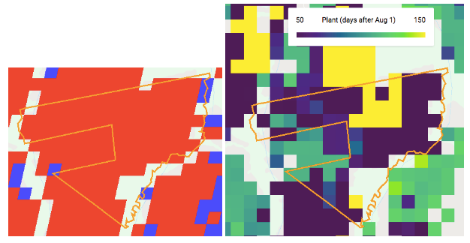
'COD_IMOVEL' = 'MT-5107925-09A842551CD64386B9B05DC7ACE437BC'
Harvest year 2016
What happened to the estimates here? Look at pixel level EVI across the field.
From Planet images, seem to have double cropped over entire

Slide 8
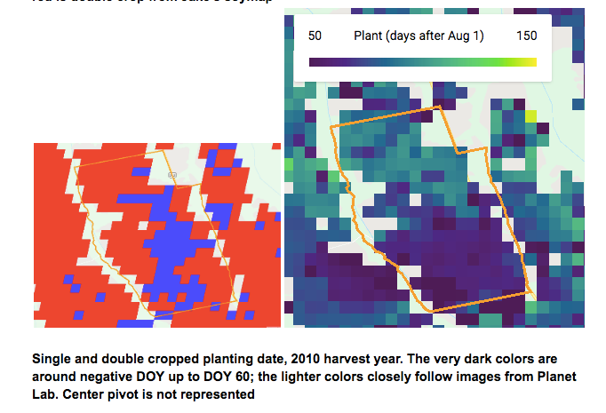
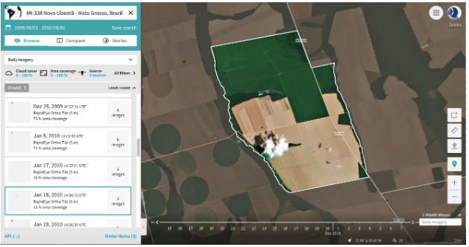
COD_IMOVEL:
MT-5107925-4EDACB98CC004C3DA7FC9B929344EF80
Harvest year 2010: Look at what EVI timeseries looks like for center pivot and for the ‘unreasonable’ planting date estimates. For this year, the southern portion had a completely different crop cycle than the northern section.

Slide 9
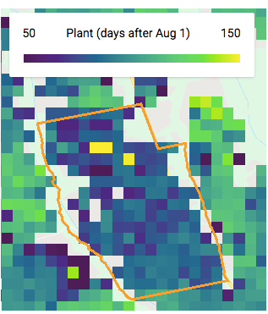
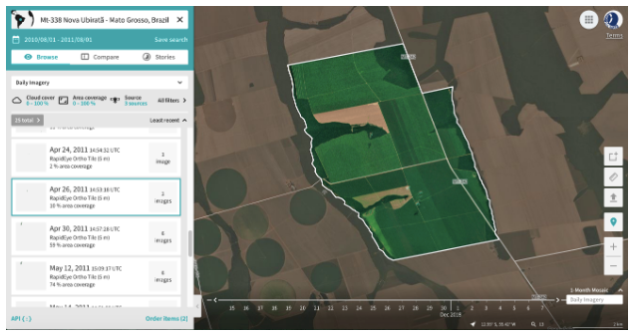
COD_IMOVEL: MT-5107925-4EDACB98CC004C3DA7FC9B929344EF80
- Harvest year 2011: note that the yellow pixels here seem to correspond with a dirt patch in Planet imagery

Slide 10
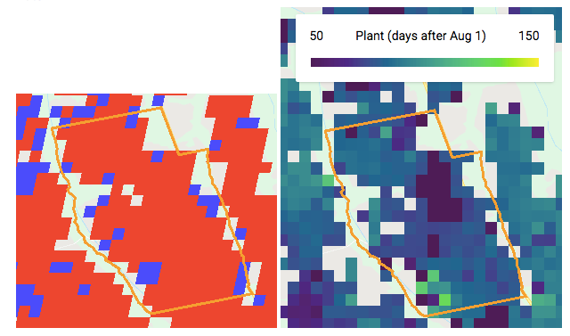
COD_IMOVEL: MT-5107925-4EDACB98CC004C3DA7FC9B929344EF80
Harvest year 2014: look at the reason behind this large variation in pixel level estimates

Slide 11
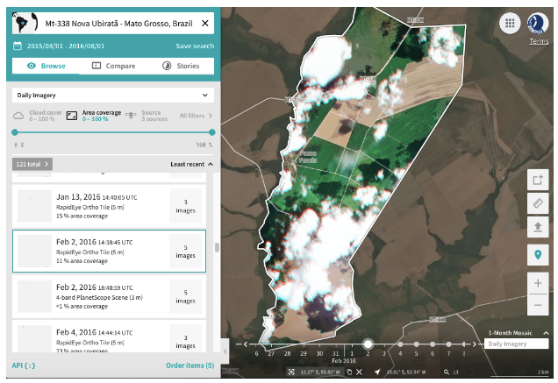
COD_IMOVEL: MT-5104526-33BDD314E97447B3A8F951BE8BD4BE7B
Harvest year 2016: harvest happened in distinct chunks – harvest was still going on for first crop when second crop already greened up in other areas. See if this is reflected in estimates.

Slide 12
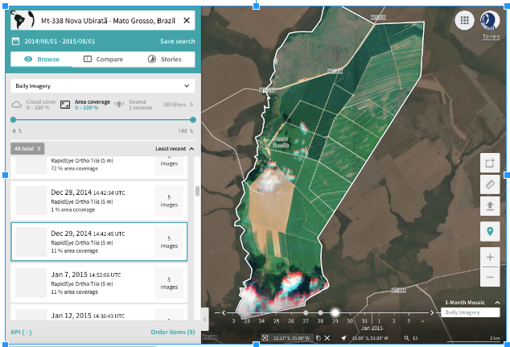
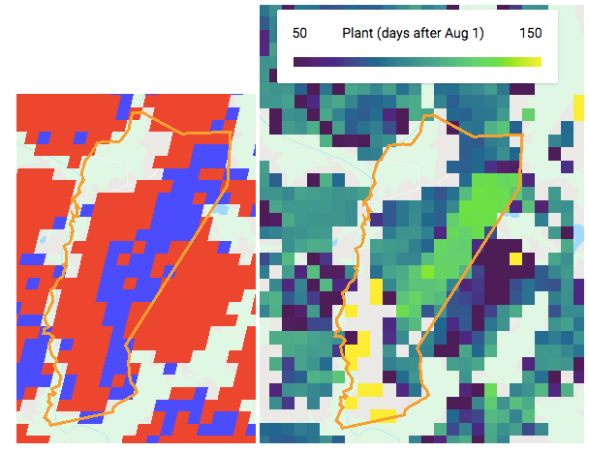
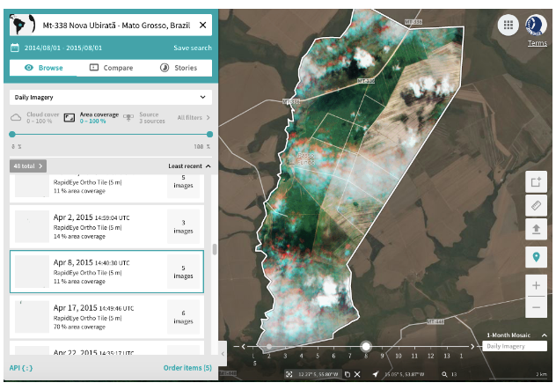
COD_IMOVEL: MT-5104526-33BDD314E97447B3A8F951BE8BD4BE7B
Harvest year 2015: look at pixel level timeseries. Planet images don’t really show time progression. Unlike what Jake’s map shows, all pixels here are double cropped; the east side is just later than the west side.

Slide 13
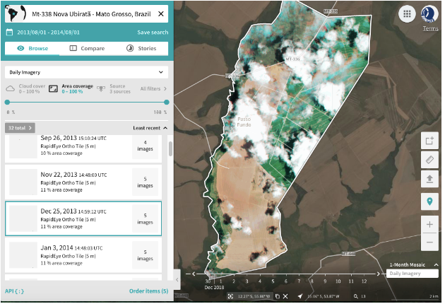
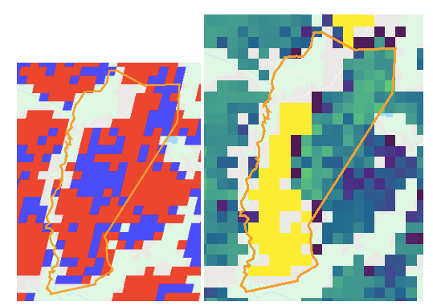
COD_IMOVEL: MT-5104526-33BDD314E97447B3A8F951BE8BD4BE7B
Harvest year 2014: Planet images show distinct west/east partition in crop timing. Look at pixel level timeseries.

Slide 14
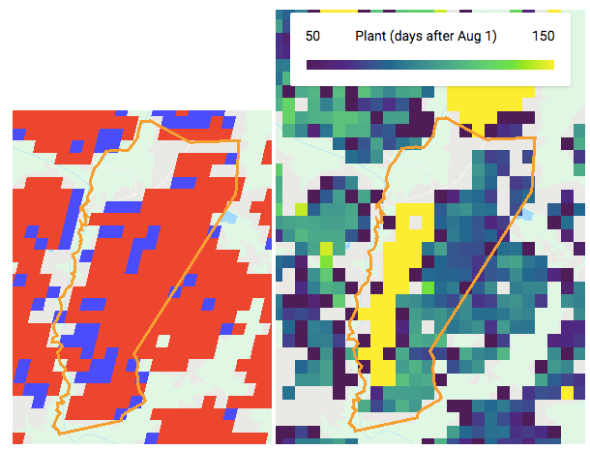
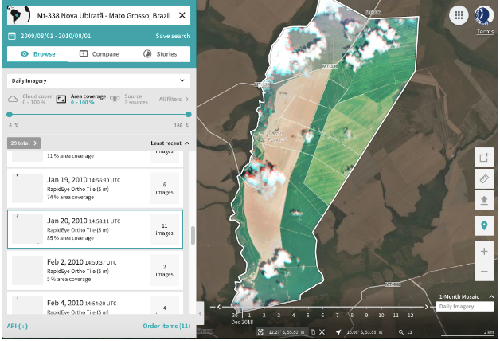
COD_IMOVEL: MT-5104526-33BDD314E97447B3A8F951BE8BD4BE7B
Harvest year 2010: Planet images show distinct west/east partition in crop timing. Look at pixel level timeseries.

Slide 15
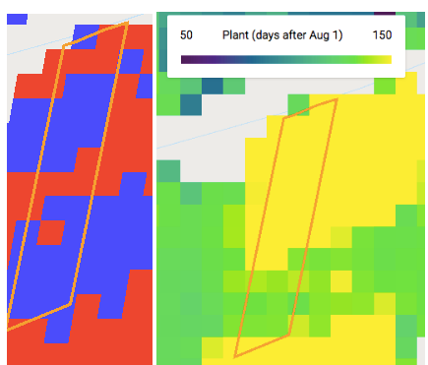
COD_IMOVEL: BA-2928901-87522FFA491C4974A534FF292712263C
Matopiba survey ID: 10
Harvest year 2016: my planting date estimates reflect Plant imagery well despite Jake’s classification. Also it’s not fair to say that a single polygon has a single planting date. The whole thing is single cropped – see if timeseries reflects this.

Slide 16
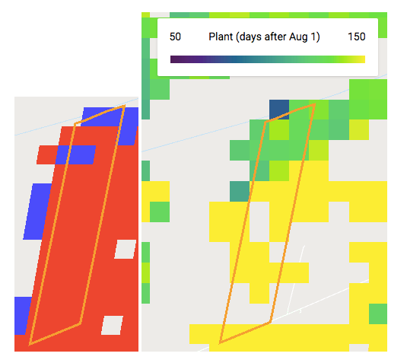
COD_IMOVEL: BA-2928901-87522FFA491C4974A534FF292712263C
Matopiba survey ID: 10
Harvest year 2011: most of the polygon is classified as double cropping, and not enough Planet images to confirm. See if timeseries can confirm. Maybe failed first crops and and different crop timings across Brazil are causing confusion. Try applying Jake’s MT-trained classifier to Matopiba to see if classifier is transferrable across space. Look at where his training points are

Slide 17
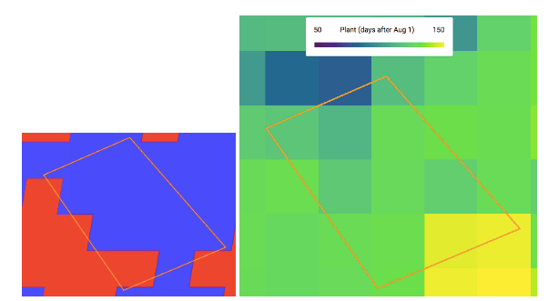
COD_IMOVEL:
BA-2919553-629DC7CD62E34C9CA2F9DB8A983A7047
Harvest year 2010: example of homogenously timed CAR poly, see if my estimates reflect that

Slide 18
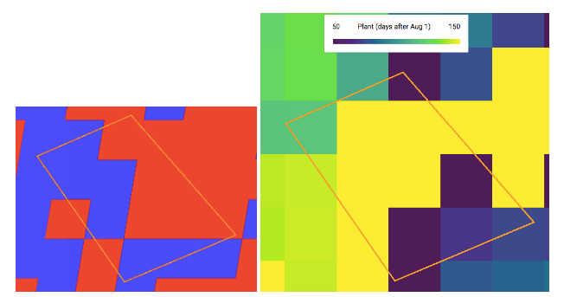
COD_IMOVEL:
BA-2919553-629DC7CD62E34C9CA2F9DB8A983A7047
Harvest year 2012: look at pixel level timeseries. Planet labs indicates the whole thing is homogenous crop timing, single cropped.

